Slide 1
Capstone Project-4
Online Retail Customer Segmentation
Individual Member
kota Lakshmana Rao

Slide 2
Content
BUSINESS UNDERSTANDING
DATA SUMMARY
FEATURE ANALYSIS
EXPLORATORY DATA ANALYSIS
DATA PREPROCESSING
IMPLEMENTING ALGORITHMS
CHALLENGES
CONCLUSIONS

Slide 3
Introduction
Customer segmentation is the practice of dividing a company’s customers into groups that reﬂect similarity among customers in each group. The goal of segmenting customers is to decide how to relate to customers in each segment in order to maximize the value of each customer to the business.
Customer segmentation has the potential to allow marketers to address each customer in the most effective way. Using the large amount of data available on customers (and potential customers), a customer segmentation analysis allows marketers to identify discrete groups of customers with a high degree of accuracy based on demographic, behavioral and other indicators.

Slide 4
Problem Statement
Identify major customer segments on transactional data using cluster analysis

Slide 5
Points for Discussion
Data summary
Feature summary
Insights from our Dataset
Analysis on top products
Analysis on bottom products
Analysis on Stock Code
Analysis on Country Based
Distribution
Analysis day Wise
Analysis Hour Wise
Analysis Numerical variable
RFM MODEL
Recency
Frequency
Monetary

Slide 6
Calculation of Silhouette score
Silhouette score and Elbow method on R , M
Silhouette score and Elbow method on F, M
Silhouette Analysis on R ,F, M
3D visualization of R, F,M
Elbow method and cluster chart on RFM
RFM ANALYSIS
Hierarchical clustering
DBSCAN ON R,F,M
Challenges
Conclusion

Slide 7
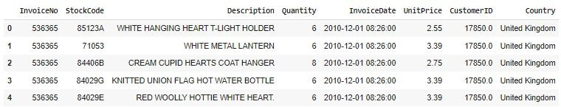
Data Summary
Total Rows : 541909
Total Column: 8
A transactional data set with transactions occurring between 1st December 2010 and 9th December 2011 for a UK-based online retailer.
Many customers of the company are wholesalers.

Slide 8
Feature Summary
The contents of the data had features such as:
InvoiceNo: Invoice number. Nominal, a 6-digit integral number uniquely assigned to each transaction. If this code starts with letter 'c', it indicates a cancellation.
Stock Code: Product (item) code. Nominal, a 5-digit integral number uniquely assigned to each distinct product.
Description: Product (item) name. Nominal.
Quantity: The quantities of each product (item) per transaction. Numeric.
InvoiceDate: Invoice Date and time. Numeric, the day and time when each transaction was generated.
Unit Price: Unit price. Numeric, Product price per unit in sterling.
CustomerID: Customer number. Nominal, a 5-digit integral number uniquely assigned to each customer. Country: Country name. Nominal, the name of the country where each customer resides.

Slide 9
Insights From our Dataset
This Dataset is from the UK
In our data set there are 541909 rows, 8 columns
Four categorical features ‘InvoiceNo’, ‘Stock Code’, & ‘Description’, ‘ Country’.
There are Missing Values present on Description & CustomerID columns, Removed null values
There are Duplicate values present, Removed duplicates
One Datetime[ns] features ‘InvoiceDate’.
Outliers present only in “Quantity” & “Unit Price”column.
Removed cancelled orders.
Added new features from datetime column such as months, days, hours.
Added Total Amount
Converted data types

Slide 10
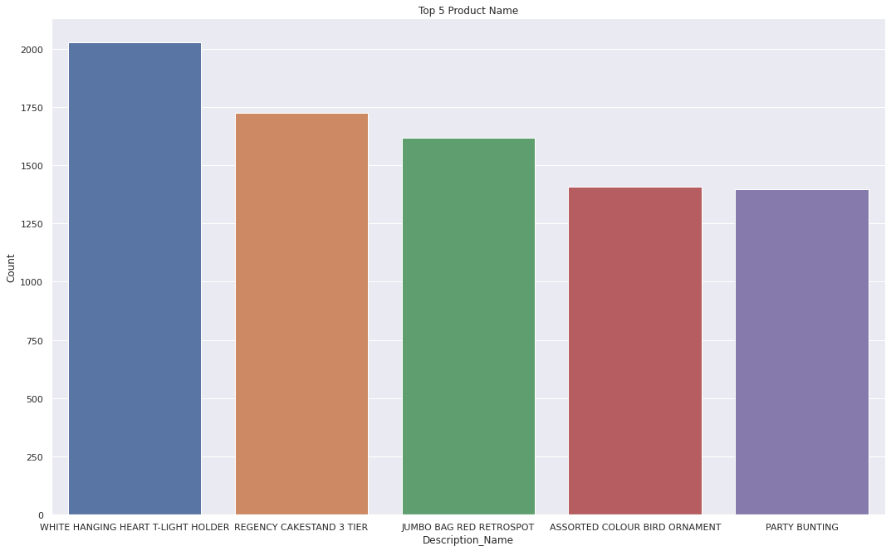
Analysis On Top Products
1.WHITE HANGING HEART T-LIGHT HOLDER, 2.REGENCY CAKE STAND 3 TIER 3.JUMBO BAG RED RETROSPOT 4.PARTY BUNTING 5.LUNCH BAG RED RETROSHOP

Slide 11
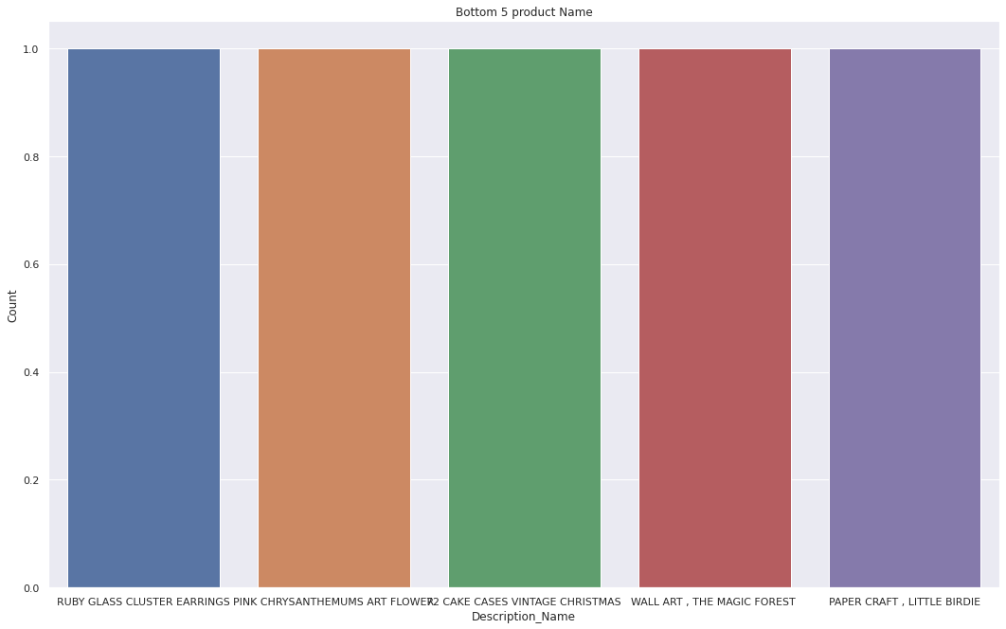
Analysis on Bottom Products
1.LIGHT DECORATION BATTERY OPERATED
2.Water damaged
3.throw away
4.re dotcom quick fix.
5.BIRTHDAY BANNER TAPE

Slide 12
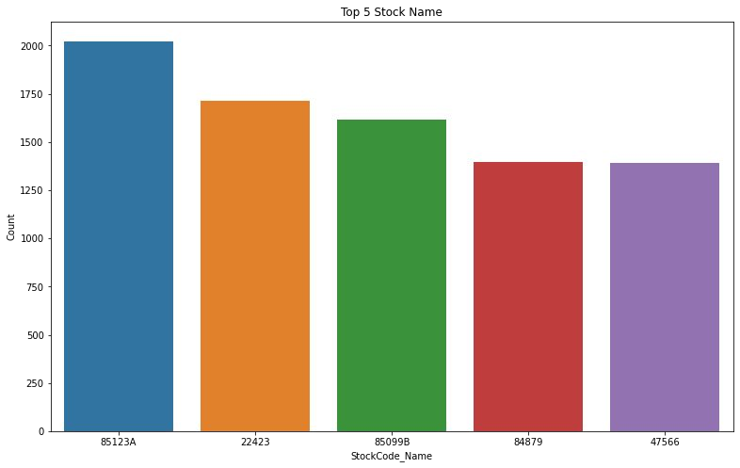
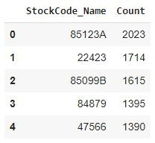
Analysis on top stock code

Slide 13
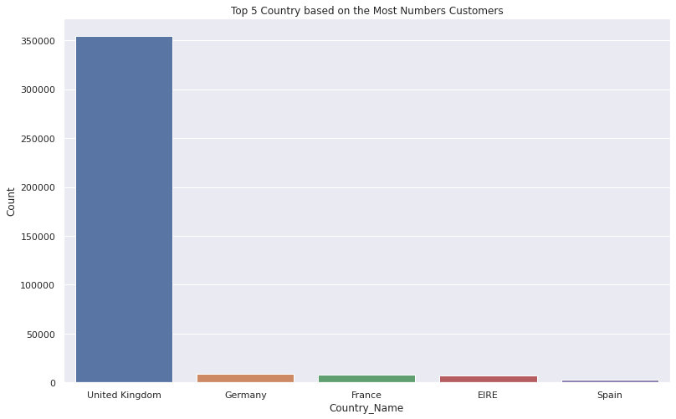
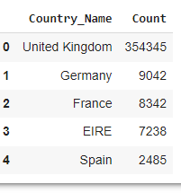
Analysis on top customers country wise

Slide 14
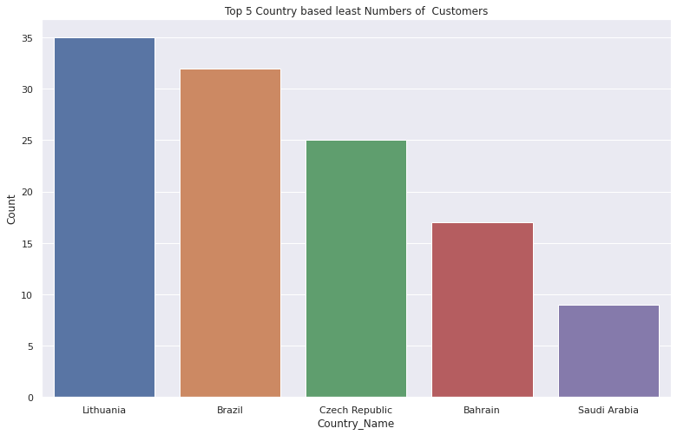
Analysis on least customers country wise
From this graph we can see that least number of customers from Lithuania, Brazil, Czech Republic ,Bahrain and Saudi Arabia

Slide 15
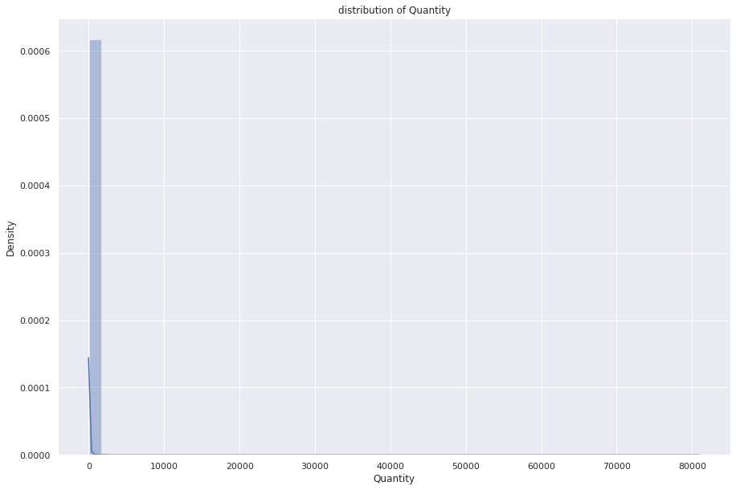
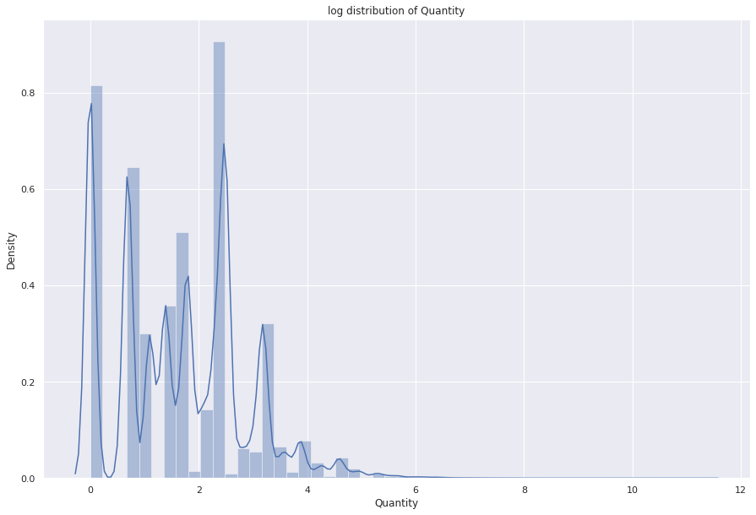
DISTRIBUTION
1.Positively skewed (or right-skewed) distribution is a type of distribution in which most values are clustered around the left tail of the distribution while the right tail of the distribution is longer.hear mean>median>mode
2. Negatively skewed (also known as left-skewed) distribution is a type of distribution in which more values are concentrated on the right side (tail) of the distribution graph while the left tail of the distribution graph is longer.hear mean<median<mode1

Slide 16
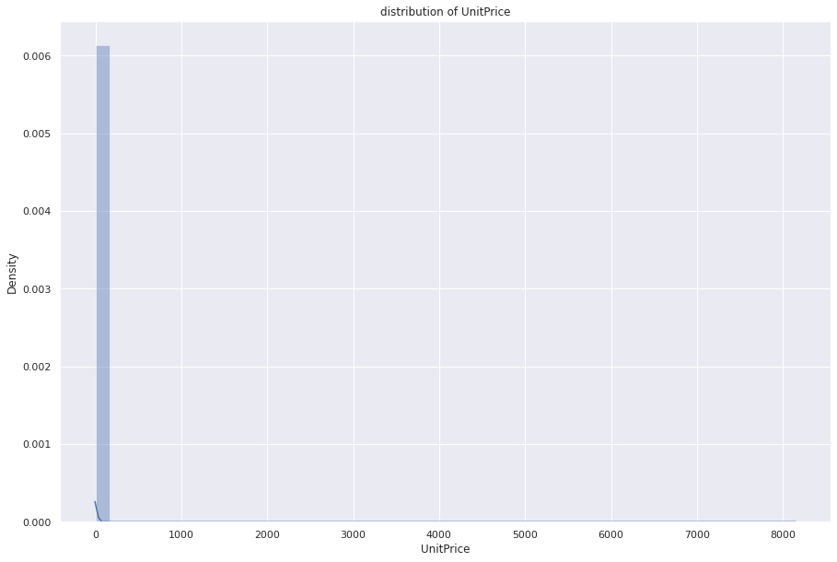
DISTRIBUTION
For symmetric graph mean=median=mode

Slide 17
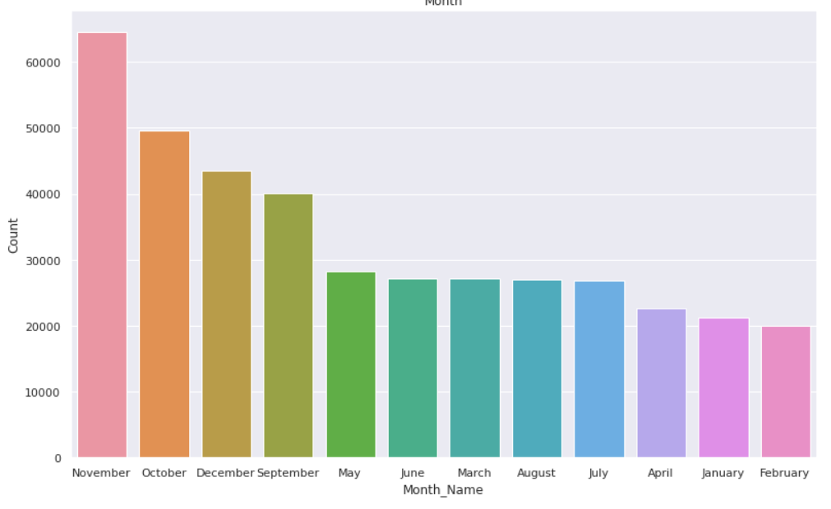
Analysis on Month wise
Most of the customers purchased gifts in september,october, november, December

Slide 18
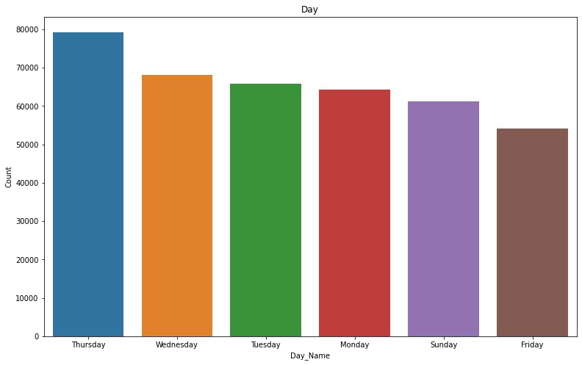
Analysis on Day wise
Most of the customers have purchased the items in Thursday, Wednesday and Tuesday

Slide 19
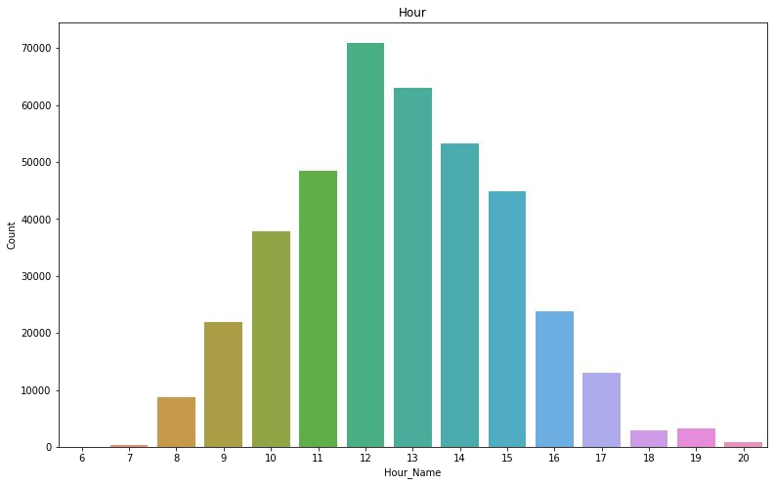
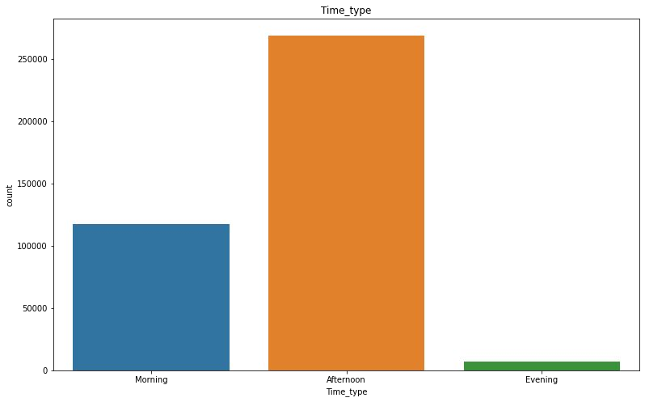
Analysis on Hours wise
Working hours witnessing most of the customer purchased item in afternoon time and moderate in morning and least in evening

Slide 20
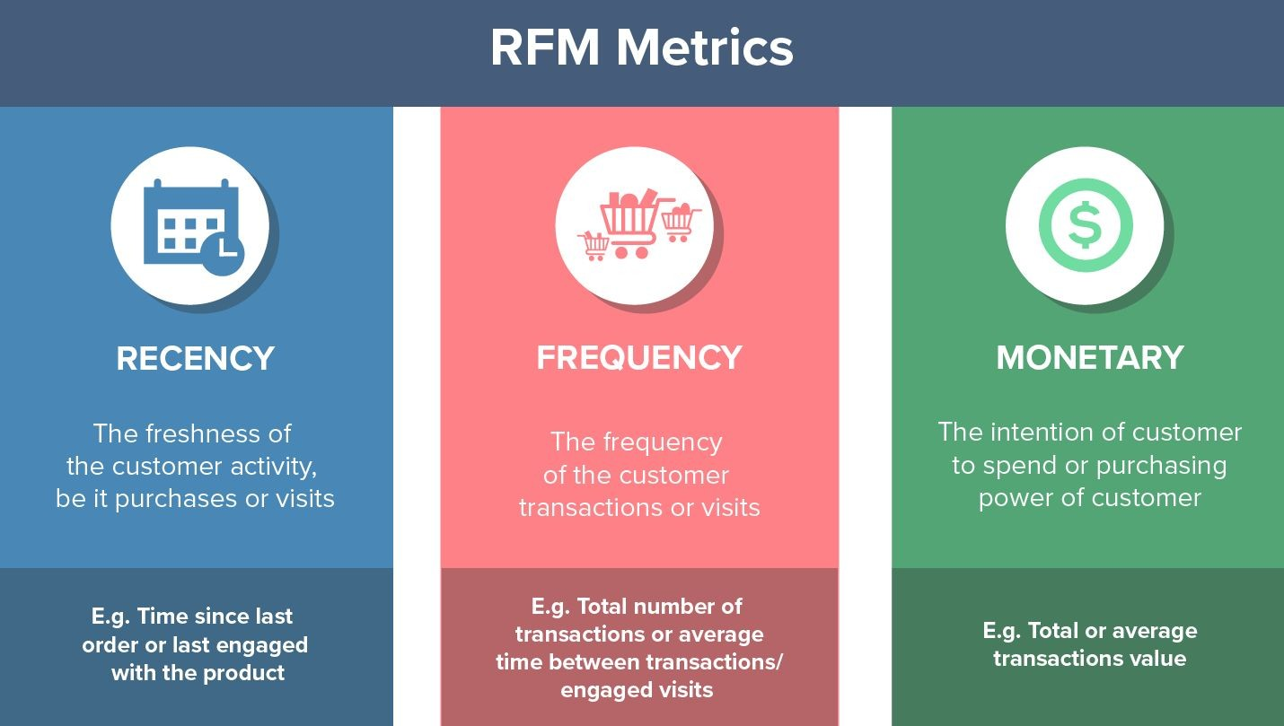
RFM MODEL
Created features such as recency, frequency and monetary

Slide 21
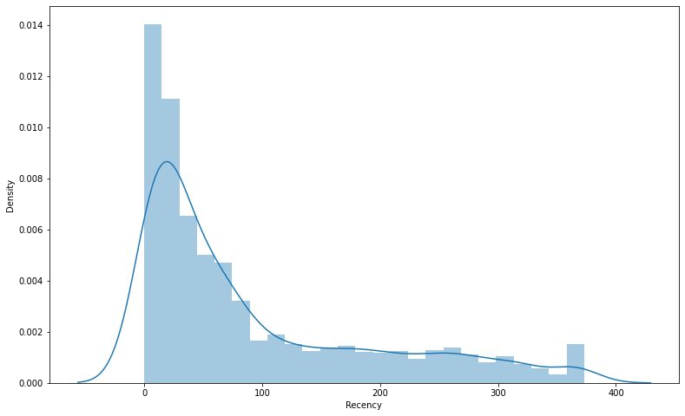
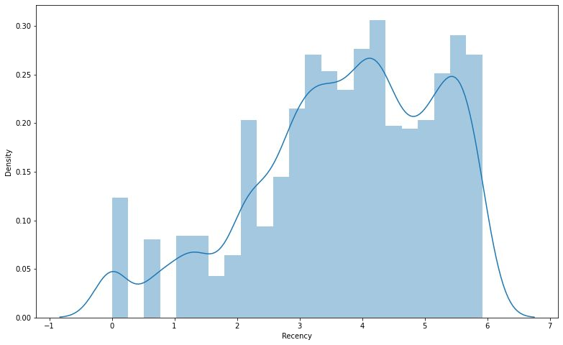
Recency
distribution before and after normal distribution with log transformation

Slide 22
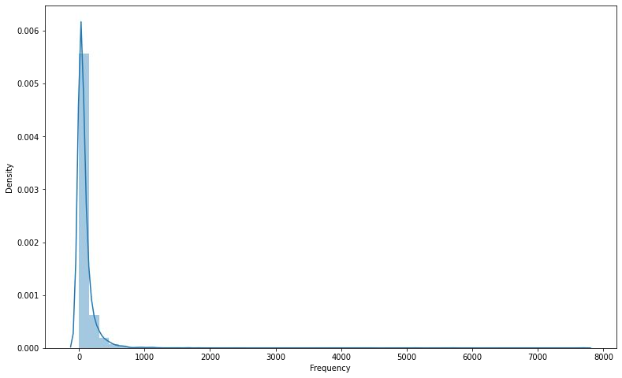
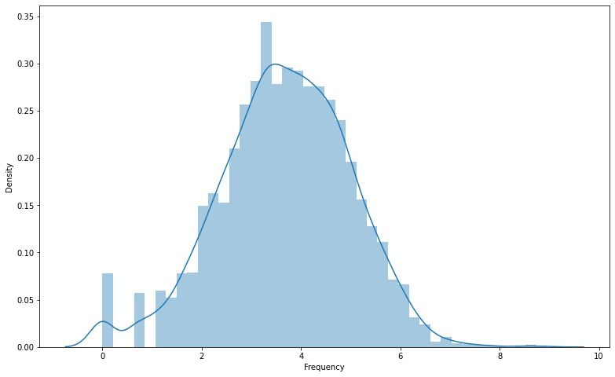
Frequency
frequency distribution plot and normal distribution after log transformation

Slide 23
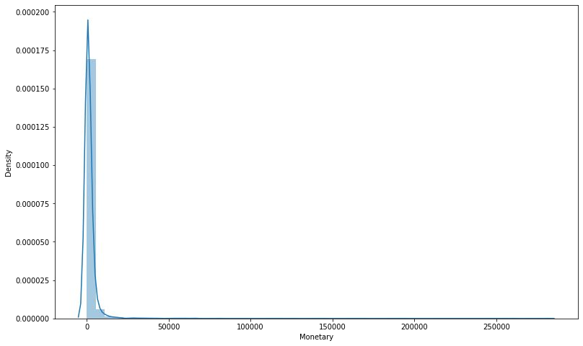
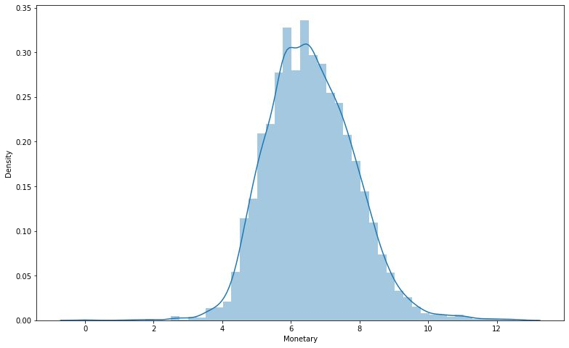
Monetary
Data distribution after data normalization for Monetary

Slide 24
Calculation of Silhouette score
Silhouette score is used to evaluate the quality of clusters created using clustering algorithms such as K-Means in terms of how well samples are clustered with other samples that are similar to each other. The Silhouette score is calculated for each sample of different clusters. To calculate the Silhouette score for each observation/data point, the following distances need to be found out for each observations belonging to all the clusters:
Mean distance between the observation and all other data points in the same cluster. This distance can also be called a mean intra-cluster distance. The mean distance is denoted by a.
Mean distance between the observation and all other data points of the next nearest cluster. This distance can also be called a mean nearest-cluster distance. The mean distance is denoted by b.
The Silhouette Coefficient for a sample is S=(b−a)max(a,b).

Slide 25
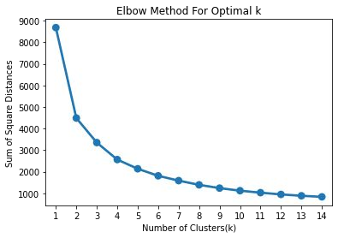
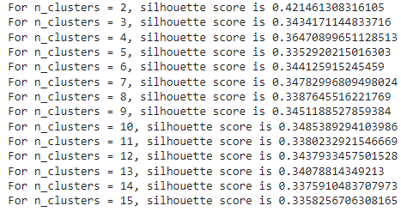
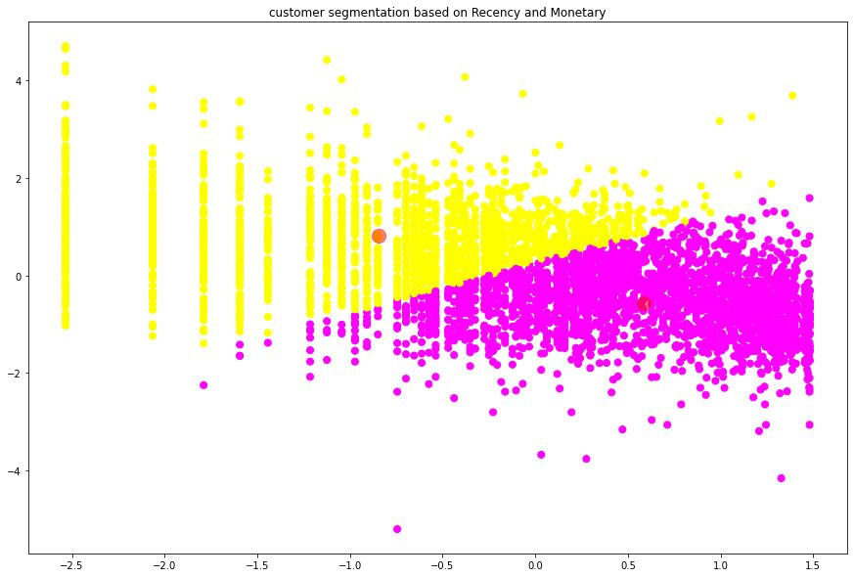
SILHOUETTE SCORE AND ELBOW METHOD ON R&M

Slide 26
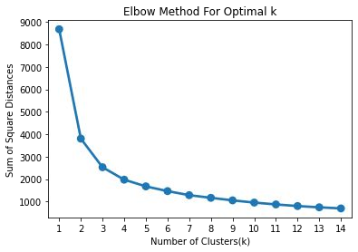
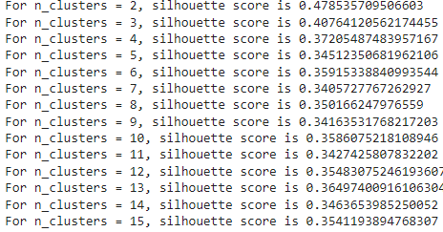
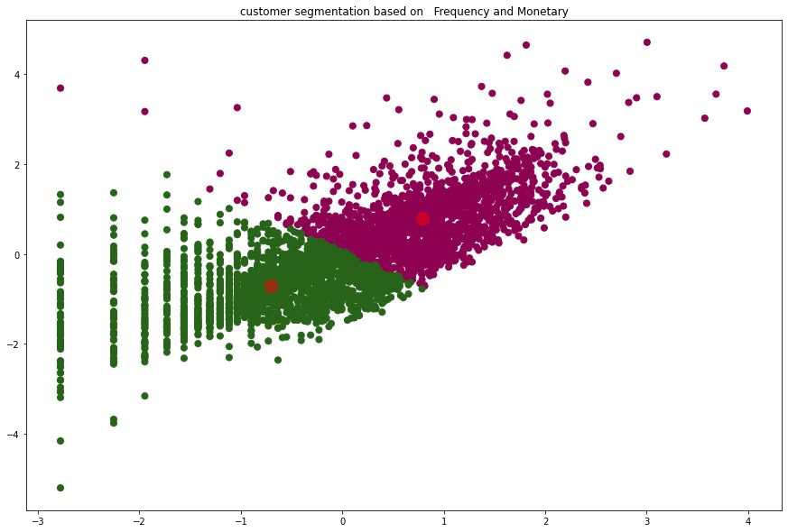
SILHOUETTE SCORE AND ELBOW METHOD ON F&M

Slide 27
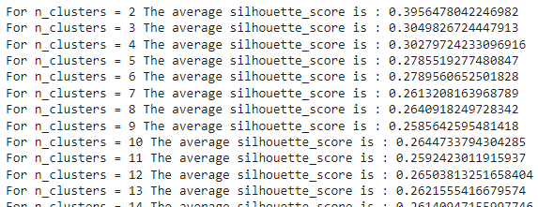
SILHOUETTE ANALYSIS ON R, F AND M

Slide 28
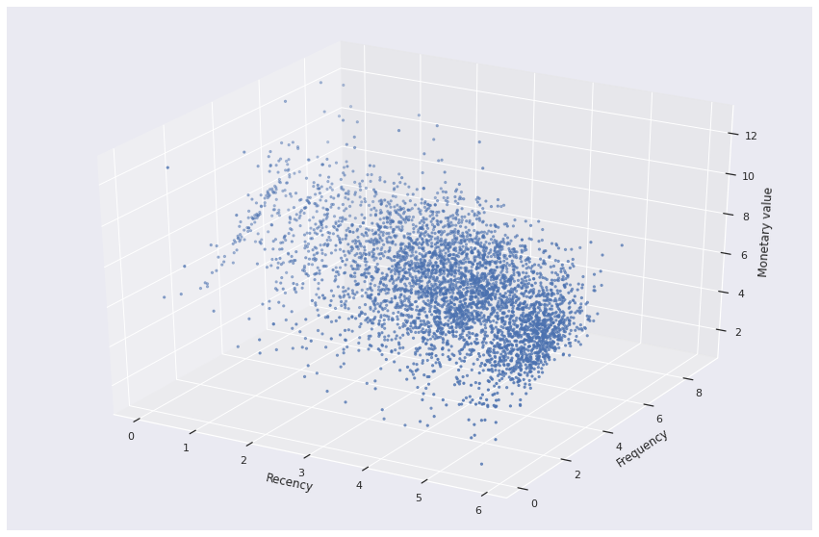
3D visualization of Recency Frequency and Monetary

Slide 29
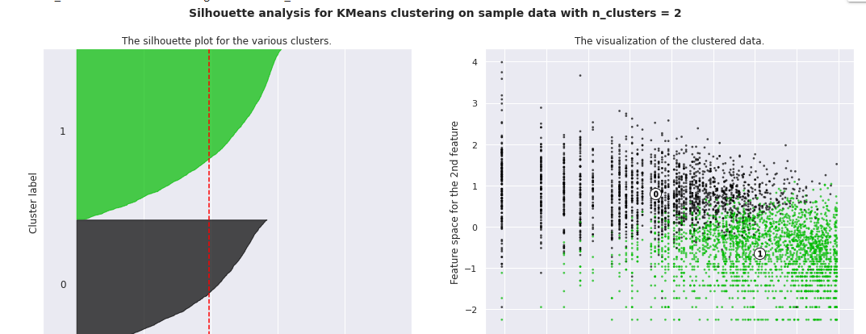
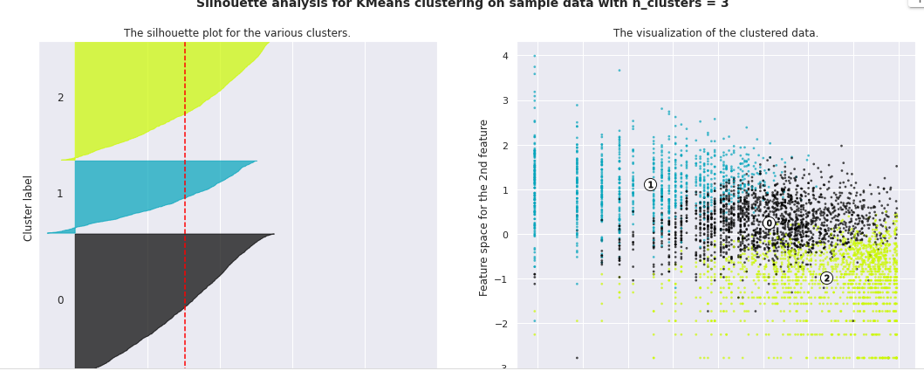
SILHOUETTE ANALYSIS ON R, F , M

Slide 30
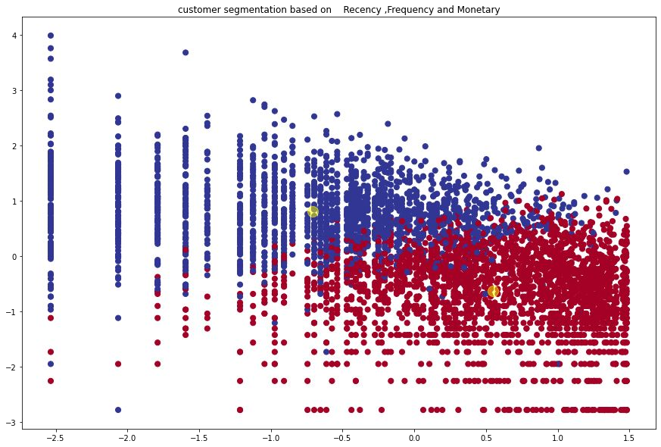
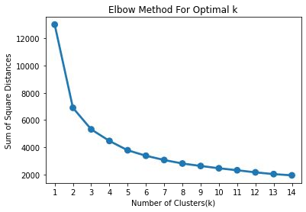
ELBOW METHOD AND CLUSTER CHART ON RFM

Slide 31
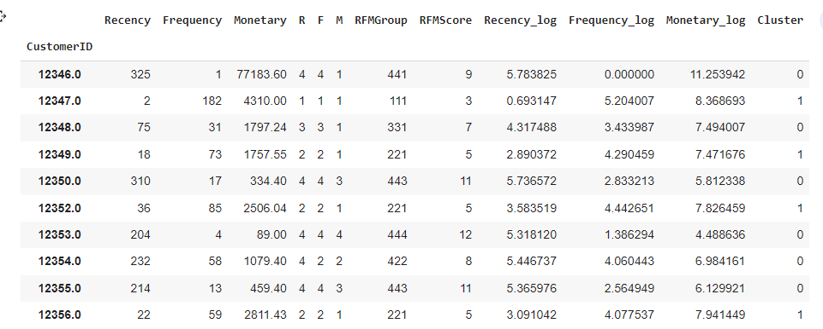
RFM ANALYSIS

Slide 32
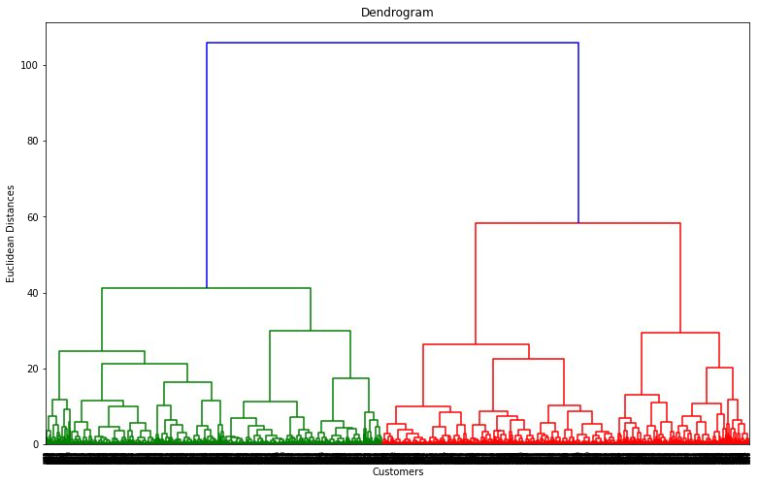
HIERARCHICAL CLUSTERING
The number of clusters will be the number of vertical lines which are being intersected by the line drawn using the threshold=90
No. of Cluster = 2

Slide 33
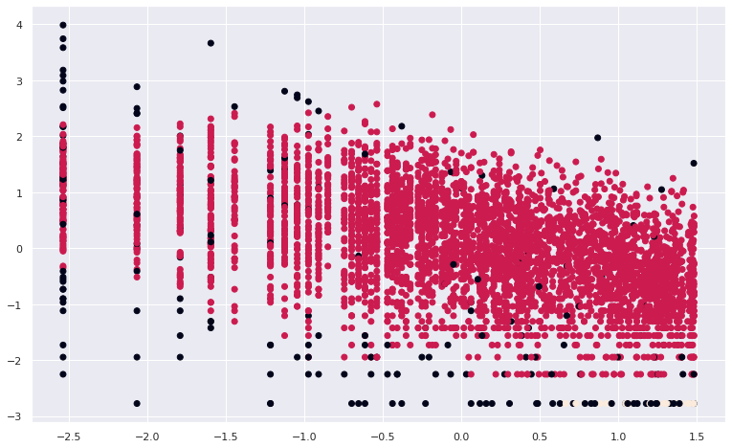
DBSCAN TO RECENCY ,FREQUENCY AND MONETARY
Density-based spatial clustering of applications with noise (DBSCAN)
we see that ,Customers are well separate when we cluster them by Recency ,Frequency and Monetary and optimal number of cluster is equal to 3

Slide 34
CHALLENGES
Large Dataset to handle.
Needs to plot lot of Graphs to analyse.
Lot of NaN values.
Continuous Runtime and RAM Crash due to large dataset.
Right number of ‘K’ for clusters

Slide 35
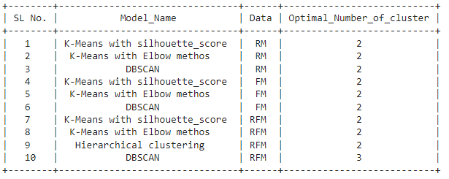

Slide 36
CONCLUSION
Throughout the analysis we went through various steps to perform customer segmentation. We started with data wrangling in which we tried to handle null values, duplicates and performed feature modiﬁcations. Next we did some exploratory data analysis and tried to draw observations from the features we had in the dataset.
Next we formulated some quantitative factors such as recency, frequency and monetary known as rfm model for each of the customers. We implemented K-Means clustering algorithm on these features. We also performed silhouette and elbow method analysis to determine the optimal no. of clusters which was 2.
We saw customers having high recency and low frequency and monetary values were part of one cluster and customers having low recency and high frequency, monetary values were part of another cluster.
We saw higher values of frequency, monetary and low values of recency is deciding one class and low values of frequency, monetary and high values of recency is deciding other class.

Slide 37
Q & A

Slide 38
THANK YOU

